Slide 1

Automated Library Circulatory System
Group 6

Slide 2
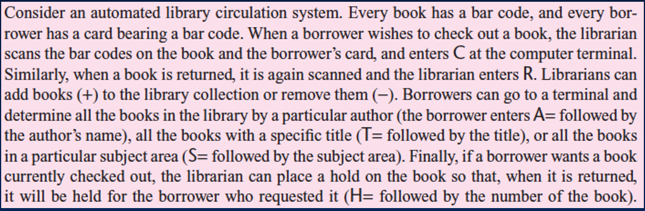

Slide 3
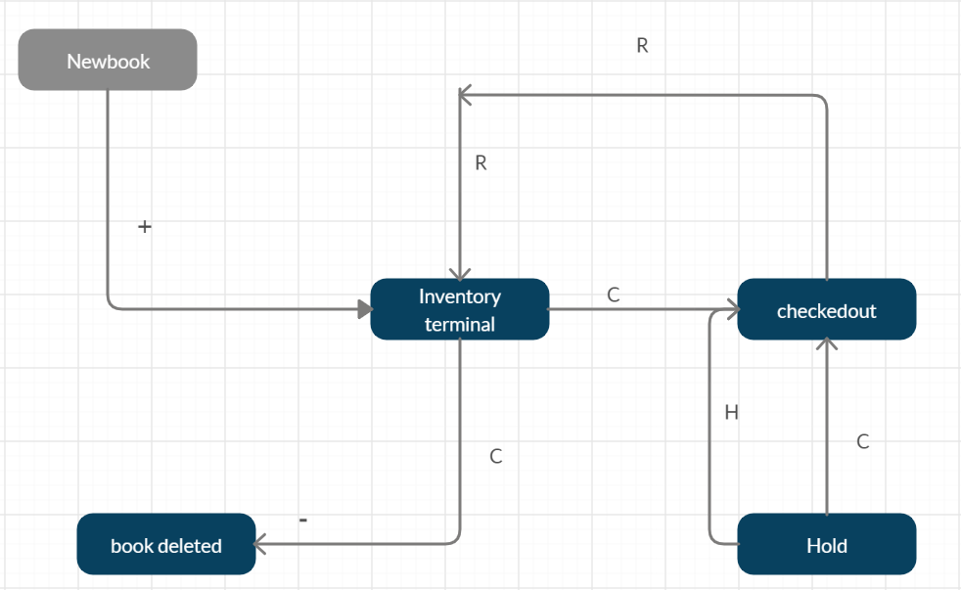

Slide 4
States :
Inventory terminal(), Checkout, Returns, Hold, Add book(intital state), Delete book
Transitions:
R(Returns), C( check out), Held, CC(Current checkout), +(adding a book ), -(deleting a book)
Inputs:
A(Author name), S(subject area), T(Title), Bc(Book code), Boc( Borrower code), H(hold number),
Bookno( book number)

Slide 5
Thankyou

